Slide 1



Galactic
Archeology
Using Ultracool Subdwarfs
Hunter Brooks, Jasmine Garani, Adam Burgasser, Roman Gerasimov, and Efrain Alvarado

Slide 2
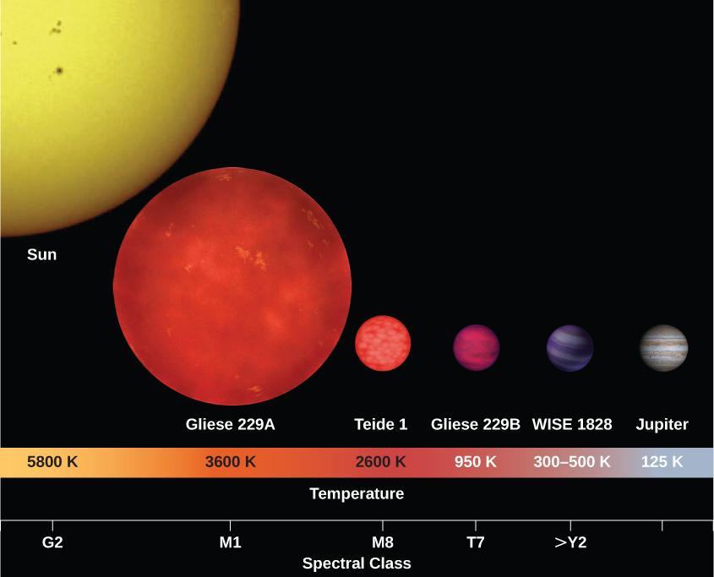
Helpful Jargon
1
Brown Dwarf
Substellar objects that do not fuse hydrogen
Stars
Figure 1
Brown Dwarf
Planet
Reference:
The Spectra of Stars, https://pressbooks.bccampus.ca/astronomy1105/chapter/17-3-the-spectra-of-stars-and-brown-dwarfs/

Slide 3
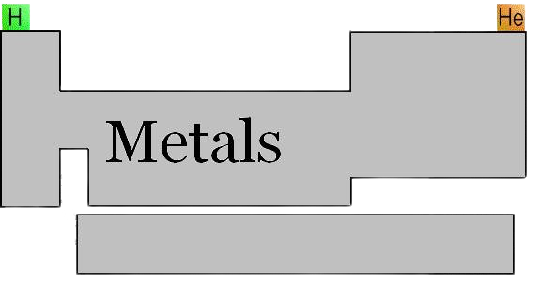
Helpful Jargon
2
Metallicity
The ratio of metals to hydrogen
Reference:
Quantumleap42, http://quantumleap42.blogspot.com/2017/10/why-neutron-star-collision-was.html
Figure 2

Slide 4
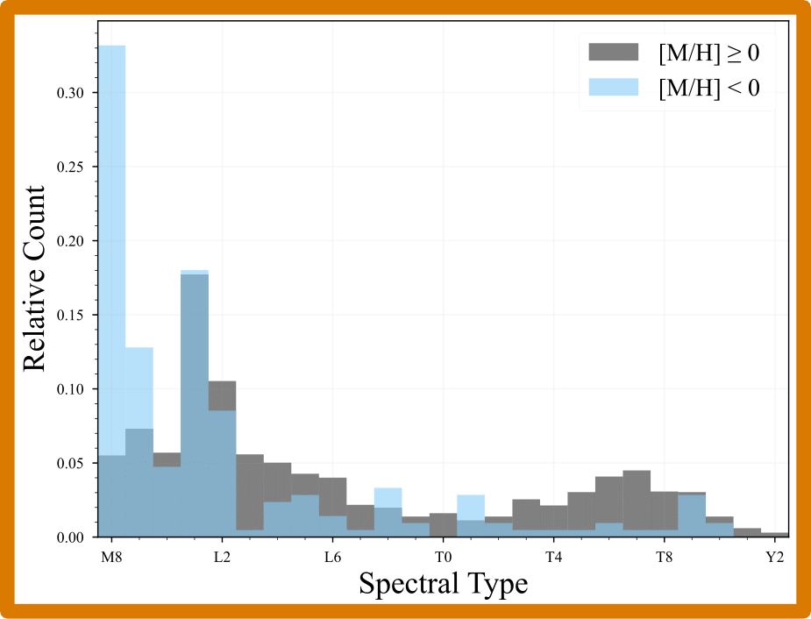
Why Should You Care?
3
Lack of low-metallicity brown dwarfs
[M/H] = 0 Peak ~ 1100 objects, [M/H] < 0 Peak ~ 100 objects
Low-Metals
Brown Dwarf
=
=
Old Age
Cool Over Time
Low-metallicity Brown Dwarfs
=
Chemical Evolution of the Milky Way
Figure 3
Colder

Slide 5
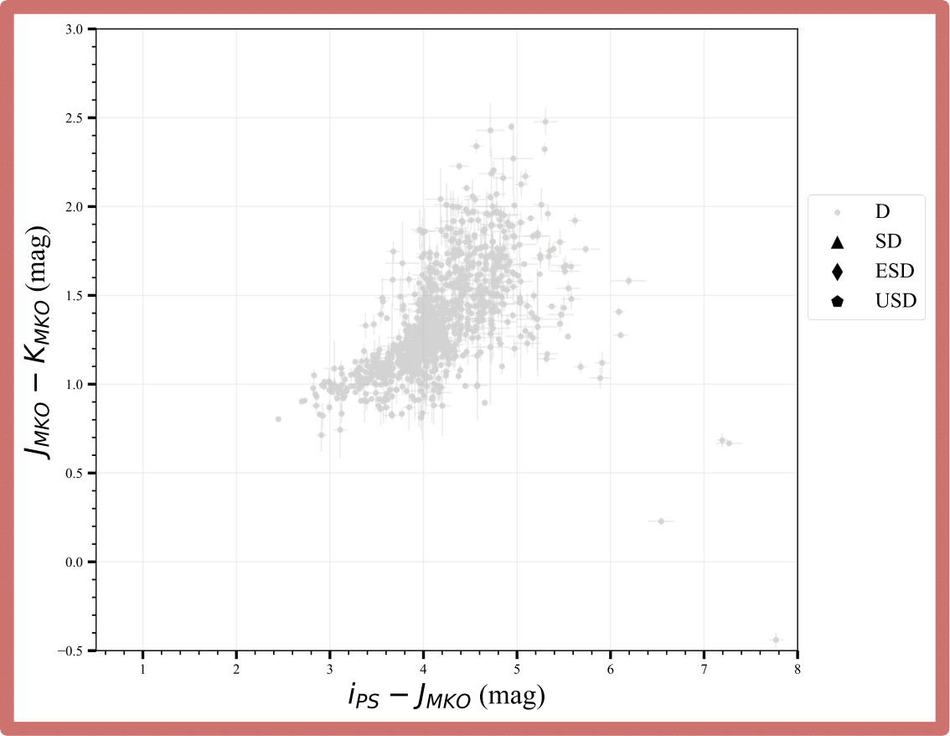
Color-Color Space
4
More Blue
Cold
Analyzed optimal color-color combinations for metal poor ultracool dwarfs using model photometry
Built a software to analysis best color-color combinations for metal poor ultracool dwarfs
Hot
Figure 4

Slide 6
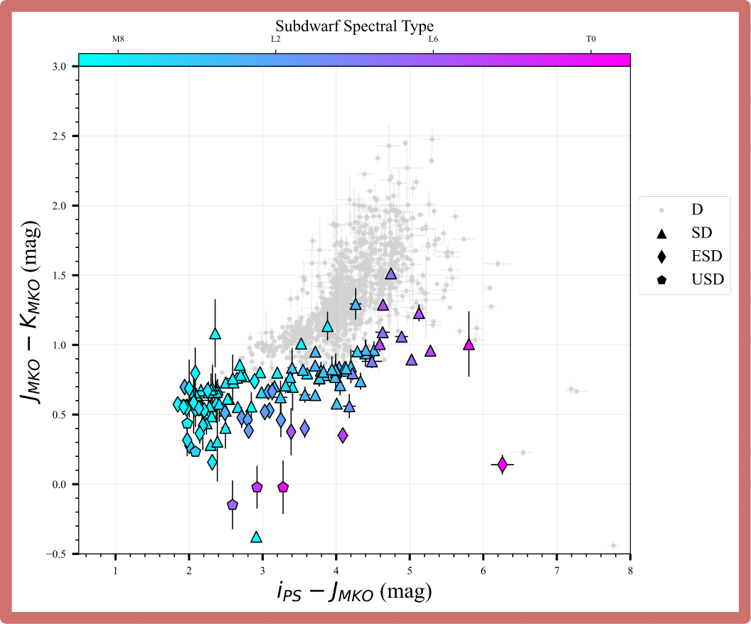
Color-Color Space
4
More Blue
Analyzed optimal color-color combinations for metal poor ultracool dwarfs using model photometry
Figure 4

Slide 7
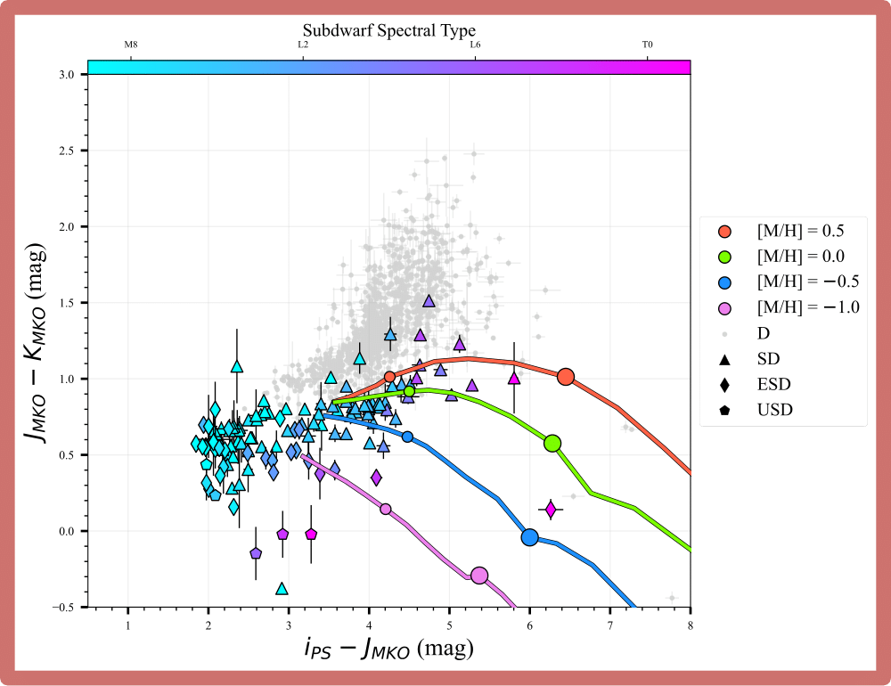
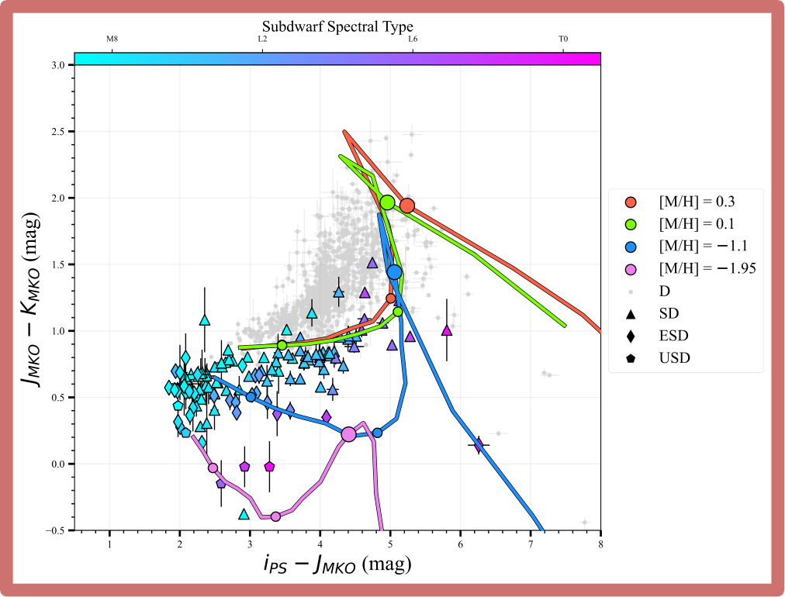
Color-Color Space
5
Figure 5
Figure 6
ELF OWL
SAND

Slide 8
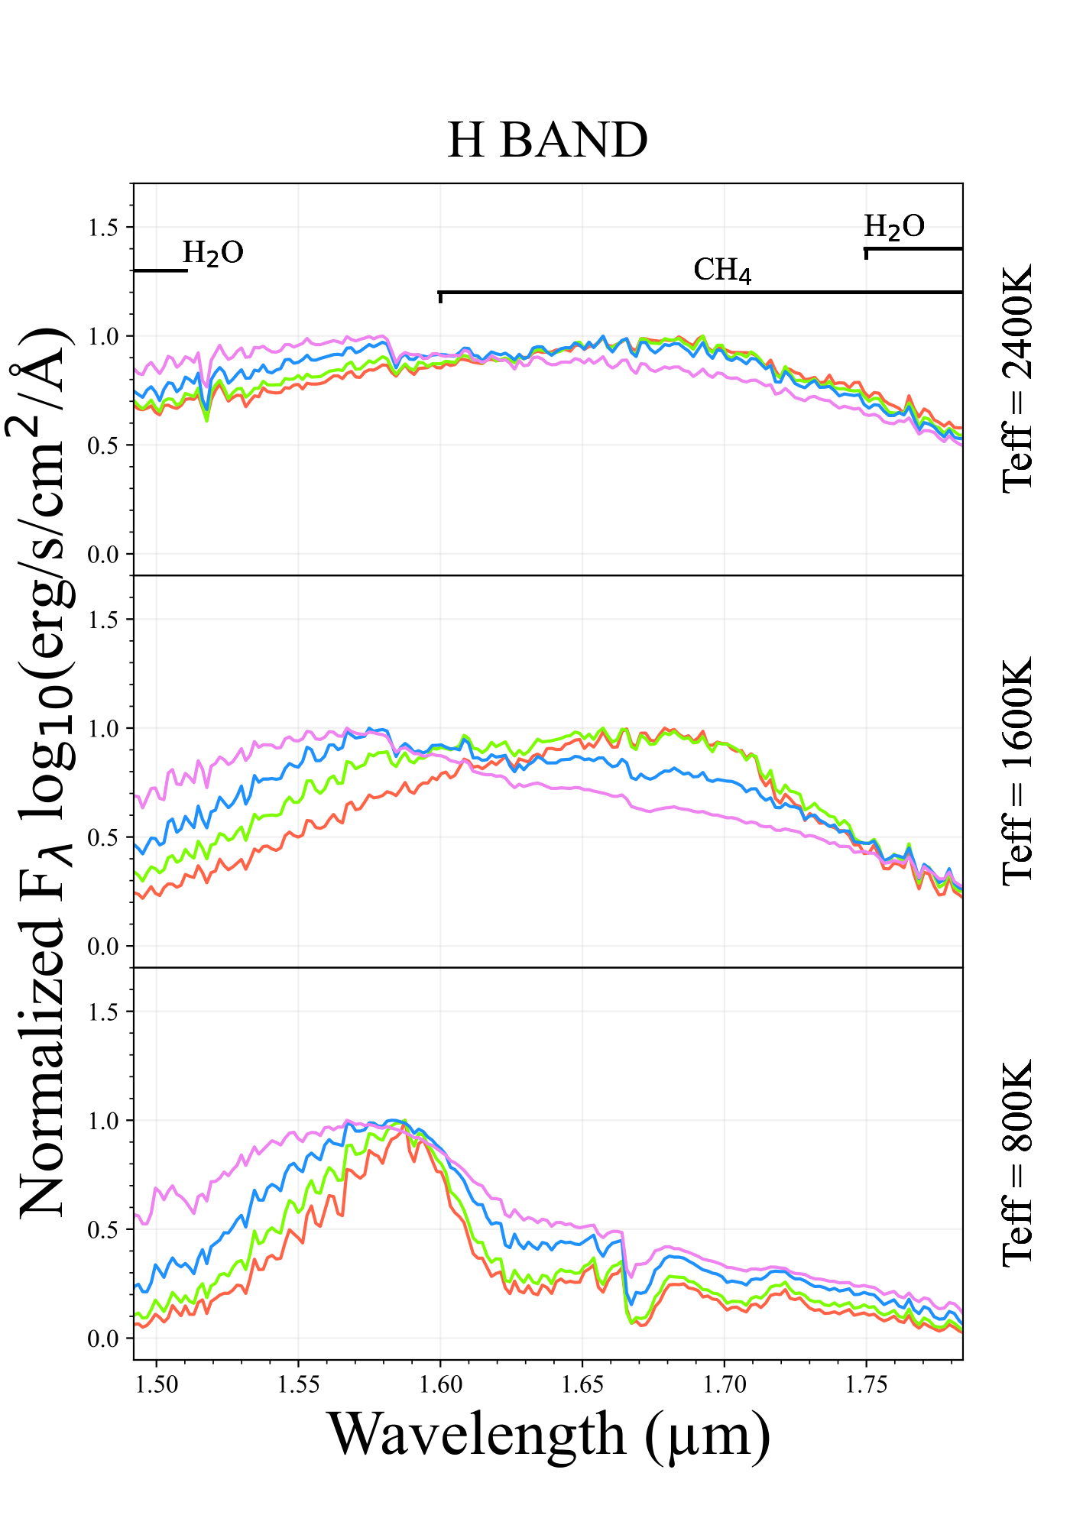
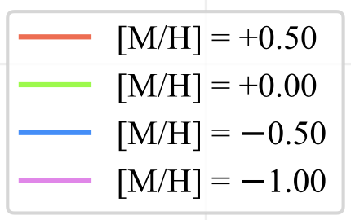
Photometric Space
6
Used color heatmaps to provide optimal spectral regions for finding metal-poor objects
Figure 7

Slide 9
What’s Next
7
Fit Model Spectra
Use statistical tests to fit model spectra to observed ultracool subdwarf spectra
Publish Paper
Look out for Brooks et al. (2025)
Author Contact
Email: hcb98@nau.edu
GitHub: @huntbrooks85

Slide 10
Conclusion
8
We utilized three ultracool metal-poor spectral models to produce numerous color-color diagrams, used to detect new subdwarfs. Additionally, we determined that metal-metal molecules and methane significantly influence these diagrams.

Slide 11
Acknowledgements
9
PEOPLE
We thank Professor Burgasser, Roman Gerasimov, Christian Aganze, Efrain Alvarado, Davy Kirkpatrick, Dan Caselden, and the Backyard World: Planet 9 team for their contributions to this work.
We thank the Northern Arizona University NASA Space Grant, and Paloma Davidson, for funding and support toward this work
SOFTWARE:
SPLAT acknowledgement: This research has benefitted from the SpeX Prism Spectral Libraries, maintained by Adam Burgasser at https://github.com/aburgasser/splat
WRAP acknowledgement: This research has benefited from the Wide-field Retrieval of Astrodata Program (WRAP), developed by Hunter Brooks at: https://github.com/huntbrooks85/WRAP
DATA:
VizieR/SIMBAD: This research has made use of the VizieR catalogue access tool, CDS, Strasbourg, France.
PANSTARRS: The Pan-STARRS1 Surveys (PS1) and the PS1 public science archive have been made possible through contributions by the Institute for Astronomy, the University of Hawaii, the Pan-STARRS Project Office, the Max-Planck Society and its participating institutes, the Max Planck Institute for Astronomy, Heidelberg and the Max Planck Institute for Extraterrestrial Physics, Garching, The Johns Hopkins University, Durham University, the University of Edinburgh, the Queen's University Belfast, the Harvard-Smithsonian Center for Astrophysics, the Las Cumbres Observatory Global Telescope Network Incorporated, the National Central University of Taiwan, the Space Telescope Science Institute, the National Aeronautics and Space Administration under Grant No. NNX08AR22G issued through the Planetary Science Division of the NASA Science Mission Directorate, the National Science Foundation Grant No. AST-1238877, the University of Maryland, Eotvos Lorand University (ELTE), the Los Alamos National Laboratory, and the Gordon and Betty Moore Foundation.

Slide 12
EXTRA
10
Figure 10
Figure 9

